Slide 1
Infectious Diseases
MedEd Y3 Written Exam

Slide 2
SESSION CONTENT
Meningitis
Infective Endocarditis
Urinary Tract Infection
Gastroenteritis
Hepatitis
Malaria

Slide 3
SESSION STRUCTURE
Aetiology
History
Presentation
Investigations
Management

Slide 4
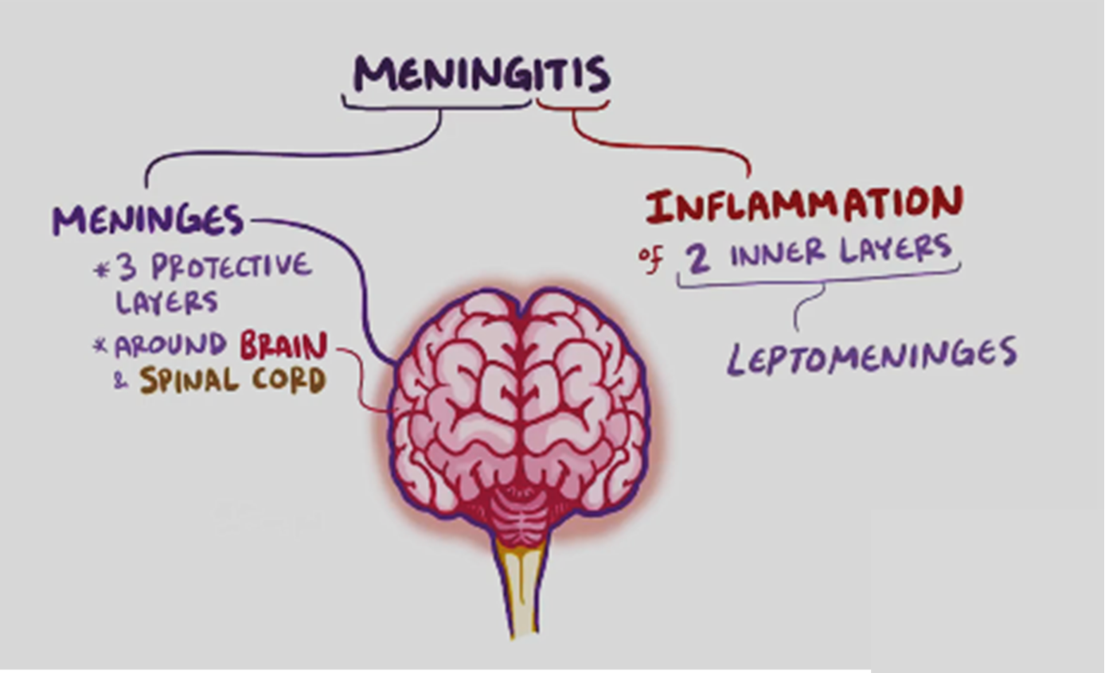
Meningitis
Definition: inflammation of the meninges, caused by viral or bacterial infection, and marked by intense headache and fever, sensitivity to light, and muscular rigidity.
Risk Factors:
Young (Infants) + Old (65+) ➔ Impaired immunity
Sickle cell disease
Ventriculoperitoneal shunt
Cochlear implants
Aetiology: Explaining Big Hot Neck Stiffness
E.coli, Group B streptococcus ➔ infants
Haemophilus influenzae ➔ kids
Neisseria meningitides (Gram –ve diplococci) ➔ young adults
Streptococcus pneumoniae (Gram +ve cocci) ➔ older adults

Slide 5
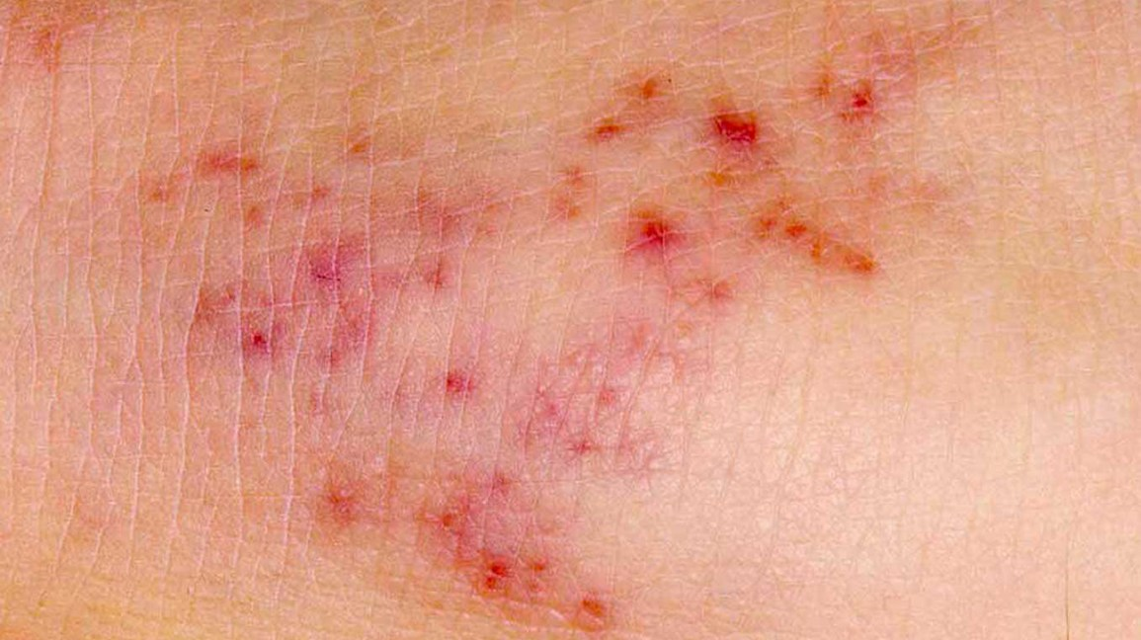
Meningitis
Signs/Symptoms:
Classic triad: Fever, Headache + Neck Stiffness
Focal neurological signs e.g., hemiparesis + hemianopia
Non-blanching, petechial rash – meningococcal septicaemia
Kernig’s sign: flexing the thighs at the hip, and the knees, at 90-degree angles, and assessing whether subsequent extension of the knee is painful
Brudzinski’s sign: forced flexion of the neck elicits a reflex flexion of the hips.

Slide 6
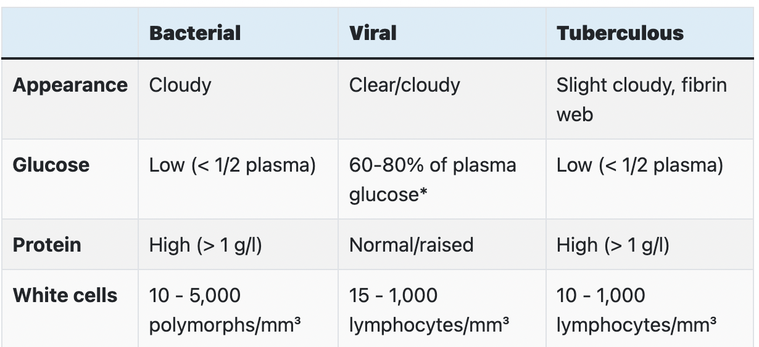
Meningitis
Bloods: Two sets of blood cultures
Imaging: CT scan looking for brain herniation exclude raised intracranial pressure (not routine)
Lumbar puncture: Send CSF for MC&S and Gram staining to confirm diagnosis
Avoid/Delay LP if:
signs of severe sepsis or a rapidly evolving rash
severe respiratory/cardiac compromise
significant bleeding risk
Signs of raised ICP
CSF Analysis
Neutrophils = Bacterial vs Lymphocytes = Viral/TB

Slide 7
Meningitis
Non-blanching rash or meningococcal septicaemia: Admit/call an ambulance + give IV benzylpenicillin (hospital)/IM benzylpenicillin (pre-hospital setting i.e. GP)
In Hospital: ABC approach
Stable:
IV Cefotaxime/Ceftriaxone (3rd generation cephalosporin) ➔ 3 months to 50 years
IV Cefotaxime/Ceftriaxone + Amoxicillin/Ampicillin ➔ >50yrs
IV Dexamethasone – if pneumococcal suspected but not in septic shock, meningococcal septicaemia or immunocompromised
Severe Sepsis: IV antibiotics + IV fluid resuscitation
If consciousness affected, consider IV acyclovir to cover encephalitis
Close contact prophylaxis (if within 1 week before onset) : rifampicin/ ciprofloxacin

Slide 8
Meningitis: Summary slide
Aetiology:
Examination:
Investigations:
Explaining Big Hot Neck Stiffness
Petechial rash ➔ meningococcal septicaemia
Focal neurological sign
Kernig’s sign
Brudzinski’s sign
Bloods: two sets of blood cultures
Lumbar puncture: for CSF analysis
Avoid LP: severe sepsis, raised ICP, developing rash
Young (infants) and Old (65+) – main risk factor
History:
Management:
Complications:
Classic Triad: Fever, Headache + Neck Stiffness
First line
Non-blanching/Meningococcal: Admit/Call Ambulance + IV/IM benzylpenicillin
Stable:
IV Cefotaxime/Ceftriaxone ➔ 3 months to 50 years
IV Cefotaxime/Ceftriaxone + Amoxicillin/Ampicillin ➔ >50yrs
IV dexamethasone – suspected pneumococcal
Sensorineural hearing loss
Seizures
Waterhouse-Friedrichsen Syndrome: adrenal haemorrhage 2ry to meningitis
Notes:
Example of summary slide.
Feel free to rearrange blocks to fit your content
Do not write full prose; use bullet points

Slide 9
Infective Endocarditis
Definition: inflammation of the endocardium as well as the valves that separate each of the four chambers within the heart
Risk Factors:
Valvular/heart disease
IV drug use
Valve replacement/prosthetic valves
Long standing catheter
Dental Work/Poor dentition
Immunodeficiency
Aetiology
Staphylococci:
Staph aureus: most common
Staph epidermis: <2 hours of recent surgery
Streptococci:
Strep viridans: poor dentition/after dental procedure
Strep bovis: colorectal cancer

Slide 10
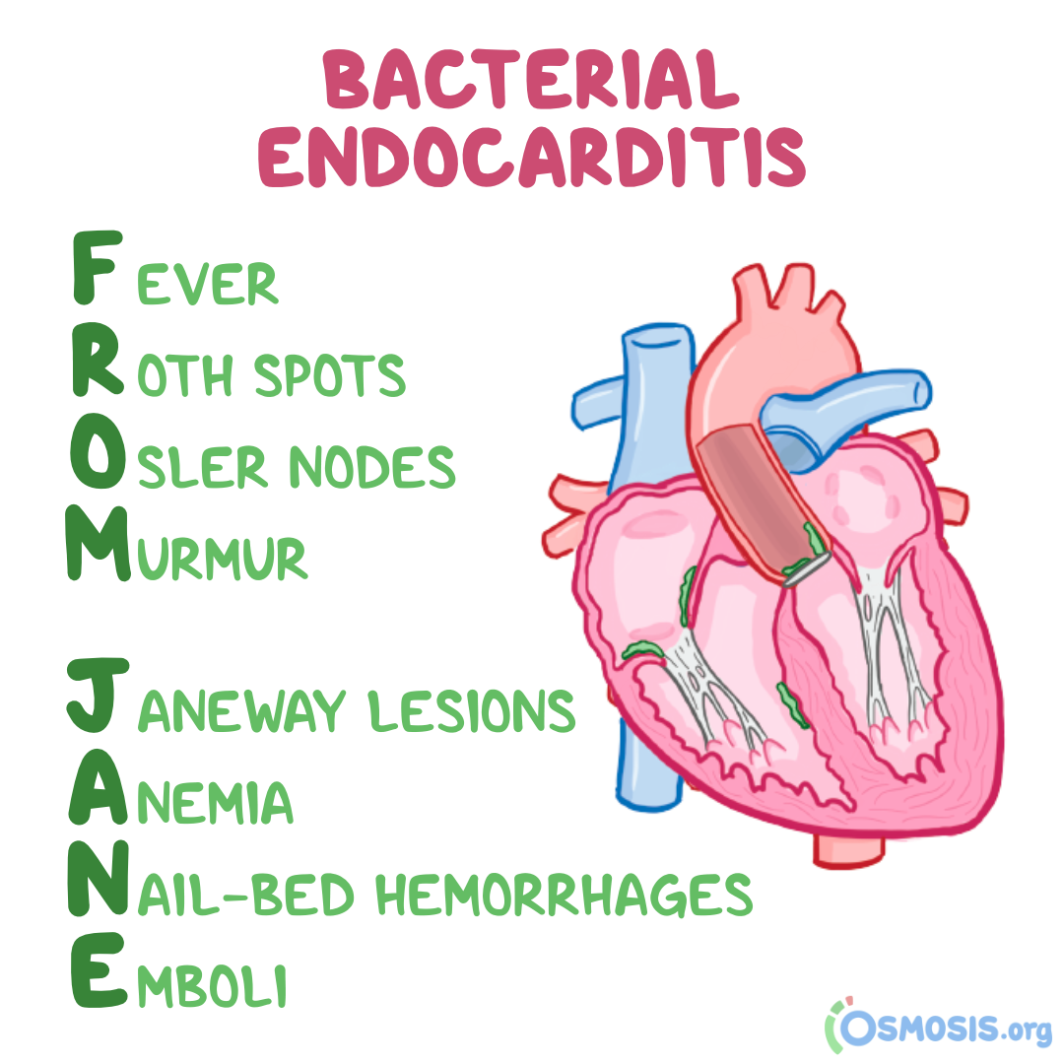
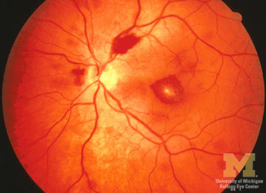
Infective Endocarditis
Signs/Symptoms: FROM JANE
Fever with sweats/rigors
Roth spots on fundoscopy – small flame shaped haemorrhage with white spot in the middle
New regurgitation murmur
Frequency: Mitral > aortic > tricuspid > pulmonary
Tricuspid ➔ associated with IV drug use
Finger clubbing (remember for cardio OSCE)
Splenomegaly due to splenic artery occlusion
Hands:
Splinter Haemorrhages
Osler nodes: painful, red-purple, slightly raised, tender lumps, often with a pale centre; Osler ➔ Ouch
Janeway lesions: non-tender, often haemorrhagic and occur mostly on the palms and soles on the thenar and hypothenar eminences

Slide 11
Infective Endocarditis
Investigations:
Routine Bloods: FBC ➔ high neutrophils, normocytic anaemia; Raised ESR + CRP
ECG: lengthened PR interval ➔ aortic abscess
3 blood cultures: 1 hr apart, WITHIN 24 HOURS
Urgent transthoracic echocardiogram (Transoesophageal: if prosthetic valve):
Looking for valvular abscess/vegetation
Modified Duke’s Criteria: BE TIMER
Definitive: TWO MAJOR or ONE MAJOR + THREE MINOR or FIVE MINOR
Possible: ONE MAJOR + MINOR or THREE MINOR
EXAM QUESTION CAME UP LAST YEAR ON DUKE’S CRITERIA

Slide 12
Infective Endocarditis
Management:
Antibiotics:
Refer to cardiology + infectious diseases/microbiologist for treatment
Empirical antibiotics then targeted antibiotics after sensitivity
DON’T LEARN SPECIFIC ANTIBIOTICS ➔ table on the right for interest
Surgery:
Severe valvular incompetence
Aortic abscess ➔ lengthened PR interval
Recurrent emboli after antibiotic therapy
Poor prognosis if:
Staphylococcus aureus infection
Prosthetic valve
Low complement levels
Situation | Suggested Antibiotics
Initial blind therapy | Native: Amoxicillin Prosthetic: Vancomycin + rifampicin + low-dose gentamicin
Staphylococci | Native: Flucloxacillin Prosthetic: Flucloxacillin + rifampicin + low-dose gentamicin
Streptococci | Native: Benzylpenicillin Prosthetic: Benzylpenicillin + low-dose gentamicin

Slide 13
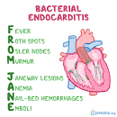
Infective Endocarditis: Summary slide
Aetiology:
Management:
Staph aureus – most common cause
Strep viridans – poor dentition/dental procedure
Staph epidermis - <2 months of surgery
Strep bovis – colorectal cancer
Risk Factors:
Valvular/heart disease
IV drug use
Valve replacement/prosthetic
Long standing catheter
Dental Work/Poor dentition
First line – Refer to cardiologist/infectious diseases ➔ empirical then targeted
Surgery: Severe valvular incompetence, Aortic abscess Recurrent emboli after antibiotic therapy
Examination: FROM JANE
Investigations: BE TIMER
Complications:
Stroke
PE
Congestive HF
Notes:
Example of summary slide.
Feel free to rearrange blocks to fit your content
Do not write full prose; use bullet points

Slide 14
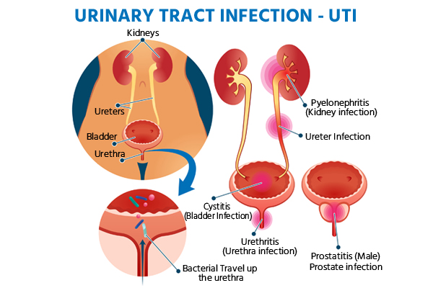
Urinary Tract Infection
Definition: presence of a pure growth of > 10⁵ colony forming units per mL of fresh MSU. UTI may affect bladder (cystitis), kidney (pyelonephritis) or prostate (prostatitis).
Risk Factors:
Women > Men; shorter urethra + anal/genital regions that are closer
Age >50
Urine outflow obstruction (BPH, stones, strictures)
Aetiology: Escherichia coli (80%), Enterococcus + Proteus mirabilis ➔ staghorn calculus
Signs/Symptoms:
Upper UT symptoms(Pyelonephritis): Fevers + Rigors + Flank Pain (Renal Angle Tenderness)
Lower UT symptoms (Prostatitis/Cystitis): Urinary Frequency, Urgency, Dysuria + Haematuria, Foul-smelling±cloudy urine, Suprapubic/loin pain and low-grade fever.

Slide 15
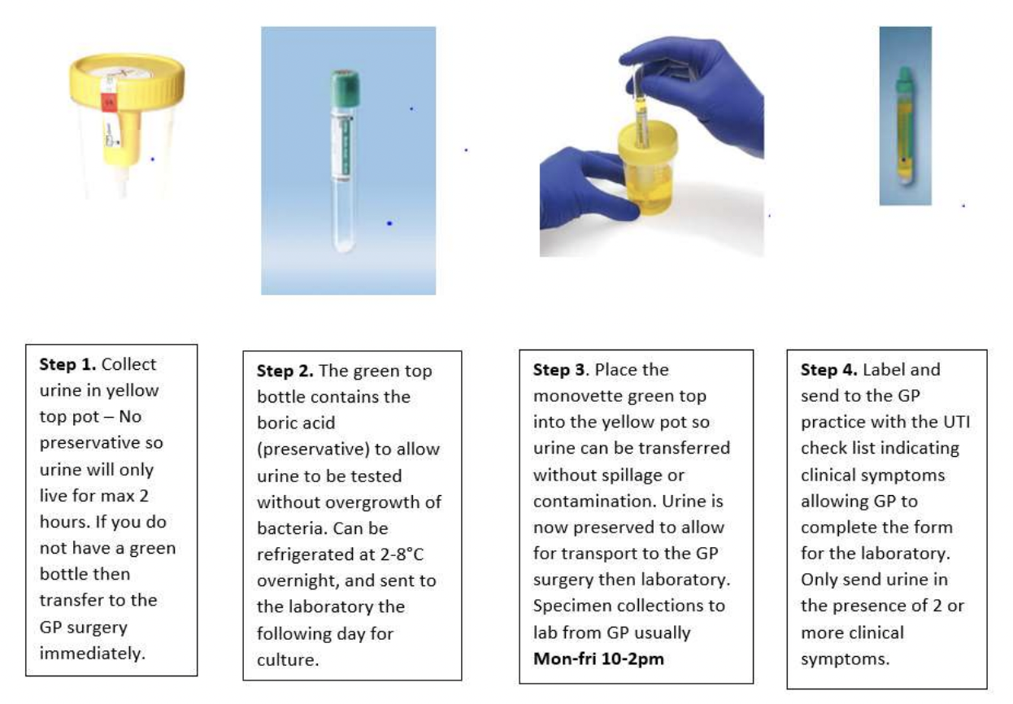
Urinary Tract Infection
Investigations:
First-line: URINE DIPSTICK ➔ positive leucocyte esterase (suggests WBC in the urine) and nitrites
Gold-Standard: Urine MC&S ➔ URINE MSU: >10⁵ CFU/mL; pyelonephritis ➔ white cell casts
Imaging: Abdominal Ultrasound to rule out urinary tract obstruction
Management:
Lower UTI:
Non-Pregnant Woman: Trimethoprim/Nitrofurantoin for 3 days
Pregnant Woman: Nitrofurantoin/Amoxicillin for 7 days (Avoid trimethoprim as it is teratogenic in 1st trimester)
Men: Trimethoprim/Nitrofurantoin for 7 days (longer course as UTIs are more “complicated” in men)
Pyelonephritis: Cefalexin for 10-14 days
NB: Avoid Nitrofurantoin in G6PD deficiency
How to perform an MSU

Slide 16
Urinary Tract Infection: Summary slide
Aetiology:
Investigations:
Presence of a pure growth of > 10⁵ colony forming units per mL of fresh MSU; E.coli = most common
First-line: URINE DIPSTICK ➔ positive leucocyte esterase and nitrites
Gold-Standard: Urine MC&S ➔ URINE MSU: >10⁵ CFU/mL; pyelonephritis ➔ white cell casts
Imaging: Abdominal Ultrasound to rule out urinary tract obstruction
Risk Factors:
Woman > Men
Age>50
Signs/Symptoms:
Management:
Complications:
Upper UT symptoms (Pyelonephritis): Fevers + Rigors + Flank Pain
Lower UT symptoms (Prostatitis + Cystitis): Urinary Frequency, Urgency, Dysuria + Haematuria, Foul-smelling±cloudy urine, Suprapubic/loin pain and low-grade fever.
Lower UTI:
Non-Pregnant Woman: Trimethoprim/Nitrofurantoin for 3 days
Pregnant Woman: Nitrofurantoin/Amoxicillin for 7 days
Men: Trimethoprim/Nitrofurantoin for 7 days
Pyelonephritis: Cefalexin for 10-14 days
Recurrent infections
Urethral Strictures
Permanent renal damage
UROSEPSIS
Notes:
Example of summary slide.
Feel free to rearrange blocks to fit your content
Do not write full prose; use bullet points

Slide 17
Gastroenteritis
Definition: Inflammation of the gastrointestinal tract caused by pathogens
Risk Factors:
Ingestion of contaminated food/water
Poor personal hygiene
Travel
Main presentation types:
Travellers’ diarrhoea: three loose/watery stools in 24 hours +/- abdominal cramps, fever, blood in stool (Enterotoxigenic E.coli ➔ most common)
Food Poisoning: sudden onset nausea, vomiting and diarrhoea after food
Signs/Symptoms:
Sudden-onset diarrhoea (>3 movements/day)
Blood/mucus in the stool
Faecal urgency
Nausea/ Vomiting
Abdominal pain or cramps
Headache
Myalgia
Bloating
Weight loss
Dry mucous membranes/reduced skin turgor ➔ DEHYDRATION
Malabsorption

Slide 18
Gastroenteritis
Viral Causes:
Presentation: Asymptomatic OR watery, non-bloody diarrhoea
Norovirus (most common) - all ages
Rotavirus - Primarily in young children <5 years
Enteric Adenovirus - Young children. Long periods of diarrhoea. (>12 days)
Cytomegalovirus - Immunosuppressed; Colitis with ulceration
Bacterial Causes: BLOODY ➔ CHESS

Slide 19
Gastroenteritis

Slide 20
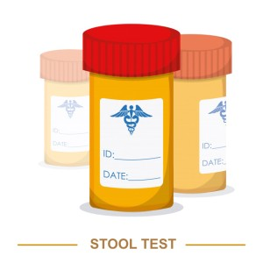
Gastroenteritis
Investigations:
Routine Bloods: Raised CRP, elevated leucocytes
Renal function and electrolytes: Impaired renal function ➔ Haemolytic uraemic syndrome
Stool MC+S (GOLD STANDARD):
Bacterial pathogens
Ova cysts
Parasites
Management:
No systemic signs: Bed rest, fluids and electrolyte replacement with oral rehydration solution (glucose + salt)
Systemic signs/Dehydration/High Fever/Symptoms > 2 weeks: Admit and give oral fluids + Antibiotics if infective organism identified ➔ Antibiotic therapy is contraindicated for enterohemorrhagic E. coli. It may increase the risk of or worsen HUS.

Slide 21
Gastroenteritis: Summary slide
Aetiology:
Signs/Symptoms:
Investigations:
Definition: Inflammation of the gastrointestinal tract caused by pathogens
Travellers’ diarrhoea: three loose/watery stools in 24 hours +/- abdominal cramps, fever, blood in stool (Enterotoxigenic E.coli ➔ most common)
Food Poisoning: sudden onset nausea, vomiting and diarrhoea after food
Routine Bloods: Raised CRP, elevated leucocytes
Renal function and electrolytes: Impaired renal function ➔ Haemolytic uraemic syndrome
Stool MC+S (GOLD STANDARD):
Bacterial pathogens
Ova cysts
Parasites
Risk Factors:
Ingestion of contaminated food/water
Poor personal hygiene
Travel
History: CHESS
Management:
No systemic signs: Bed rest, fluids and electrolyte replacement with oral rehydration solution (glucose + salt)
Systemic signs/Dehydration/High Fever/Symptoms > 2 weeks: Admit and give oral fluids + Antibiotics if infective organism identified
Notes:
Example of summary slide.
Feel free to rearrange blocks to fit your content
Do not write full prose; use bullet points

Slide 22
Hepatitis
Hepatitis A | Hepatitis B | Hepatitis C
Incubation: 2-4 weeks Transmission: Faecal-Oral route i.e., contaminated food (Hepatitis A+E ➔ Faecal) Features: flu-like prodrome abdominal pain: typically, right upper quadrant tender hepatomegaly jaundice deranged liver function tests Management: Self-limiting disease ➔ SUPPORTIVE THERAPY; avoid alcohol | Incubation: 6-20 weeks Transmission: Infected Blood/Body Fluids i.e., Contaminated needles, mother to baby (vertical transmission) Features: Fever + Jaundice + Elevated ALT/AST Management: acute ➔ supportive; chronic ➔ Pegylated interferon-alpha; vaccination (part of routine immunization for children born in the UK) Complications: Chronic Hepatitis B (“Ground-Glass Hepatocytes), liver failure | Incubation: 6-9 weeks Transmission: Blood-Blood route i.e., IV drug users Features: Asymptomatic primarily; can present with transient rise in ALT/AST, fatigue and arthralgia Management: acute ➔ supportive; chronic ➔ DAA (directly acting antivirals) e.g., Sofosbuvir/Daclatasvir +/- ribavirin Complications: Chronic Hepatitis C, Hepatocellular Carcinoma

Slide 23
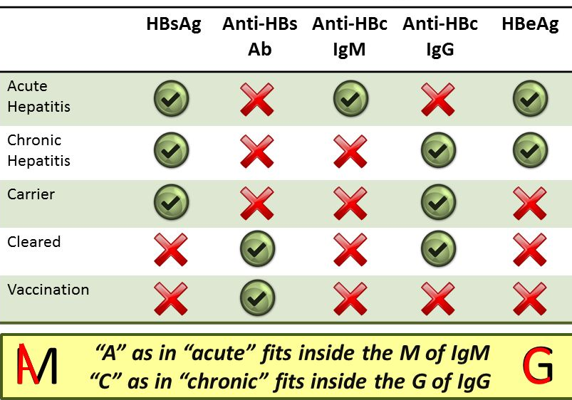
Hepatitis
TOP SEROLOGY TIPS:
HbSAg:
1-6months= ACUTE
>6 months = CHRONIC
Anti HBs = immunity
Anti-HBc = previous/current infection
Therefore:
Vaccinated: ONLY anti-HBs +ve
Previous hep B, not a carrier: anti-HBc and anti HBs +ve
Previous hep B + carrier: anti-HBc + HBsAg +Ve

Slide 24
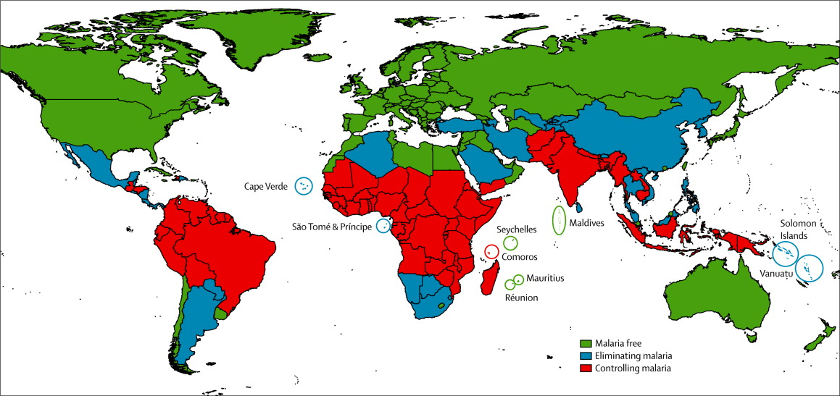
Malaria
Definition: Infection of the RBCs by plasmodium parasites; spread by female Anopheles mosquito
Epidemiology: Endemic in tropics
Aetiology:
80%: plasmodium falciparum ➔ severe malaria
20%: plasmodium vivax (most common), plasmodium ovale + plasmodium malariae ➔ “benign malaria”
Protective Factors:
Sickle cell anaemia
G6PD Deficiency
HLA-B53 (common in western Africa)

Slide 25
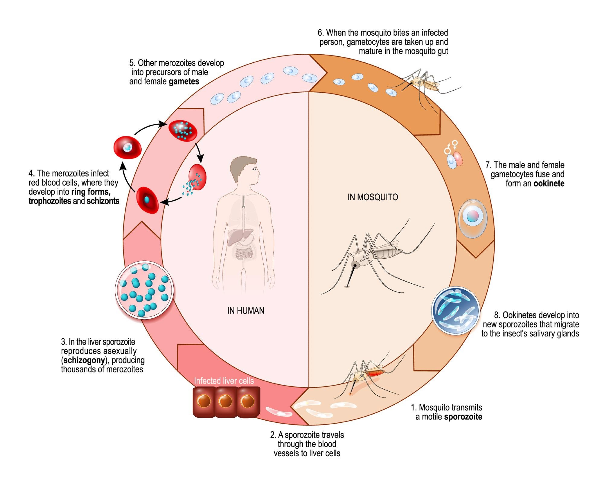
Malaria
General signs/symptoms:
Fever, headache, splenomegaly
Myalgia/Arthralgia
Falciparum malaria signs/symptoms:
Temperature > 39 °C
Severe anaemia ➔ intravascular haemolysis can lead to dark urine (blackwater fever)
Schizonts on blood film
Non-falciparum malaria signs/symptoms:
Plasmodium vivax/ovale: cyclical fever every 2 days
Plasmodium malariae: cyclical fever every 3 days and associated with nephrotic syndrome
Malaria Life Cycle (DON’T LEARN)

Slide 26
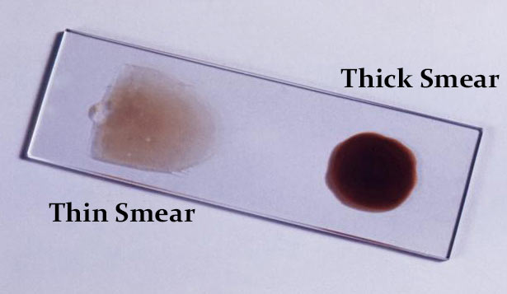
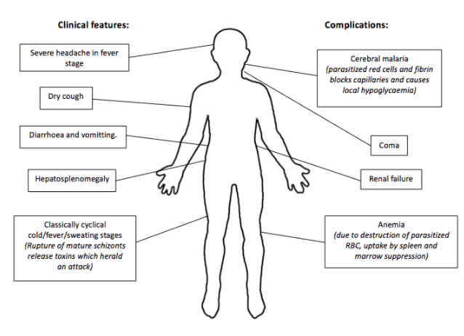
Malaria
Gold Standard Investigation: Giemsa-stained thick and thin blood smears
Thick – detects parasites present ((higher sensitivity) – can be negative in pregnancy
Thin – identifies species (higher specificity)
Management:
Uncomplicated: Chloroquine/Artemisinin combination therapy (ACT) (Avoid ACT in pregnancy)
Complicated/Severe: IV artesunate (can cause haemolysis so monitor with blood tests)

Slide 27
Malaria: Summary slide
Aetiology:
Investigations:
Definition: Infection of the RBCs by plasmodium parasites; spread by female Anopheles mosquito
Aetiology:
80%: plasmodium falciparum ➔ severe malaria
20%: plasmodium vivax (most common), plasmodium ovale + plasmodium malariae ➔ “benign malaria
Gold Standard Investigation: Giemsa-stained thick and thin blood smears
Thick – detects parasites present ((higher sensitivity) – can be negative in pregnancy
Thin – identifies species (higher specificity
Signs/Symptoms
Management:
Complications:
General signs/symptoms: Fever, headache, splenomegaly, myalgia, arthralgia
Falciparum malaria signs/symptoms:
Temperature > 39 °C
Severe anaemia ➔ blackwater fever
Non-falciparum malaria signs/symptoms:
Plasmodium vivax/ovale: cyclical fever every 2 days
Plasmodium malariae: cyclical fever every 3 days
Uncomplicated: Chloroquine/Artemisinin combination therapy (ACT) (Avoid ACT in pregnancy)
Complicated/Severe: IV artesunate (can cause haemolysis so monitor with blood tests)
Coma
Cerebral Malaria
Renal Failure
Notes:
Example of summary slide.
Feel free to rearrange blocks to fit your content
Do not write full prose; use bullet points

Slide 28
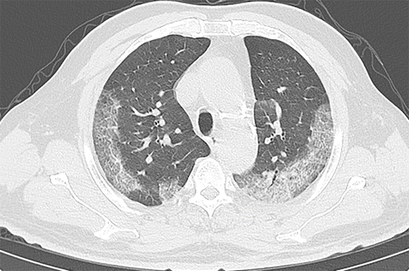
COVID-19: Summary slide
Aetiology:
Differentials:
Investigations:
A potentially severe acute respiratory infection caused by the novel coronavirus severe acute respiratory coronavirus 2 (SARS-CoV-2).
SARS-CoV-2 attaches to ACE2 receptor on target host cells. ACE2 is highly expressed in upper and lower respiratory tract but also in myocardial, renal epithelial, enterocytes and endothelial cells of multiple organs.
RT-PCR: +ve for SARS-CoV2 viral DNA
Pulse oximetry: Low O₂ saturation if moderate/severe
Routine Bloods:
CXR/Chest CT: Ground glass opacity + consolidation
Pneumonia
Influenza
Common Cold
Management:
Complications:
History:
Mild/Moderate COVID-19: Bed rest, paracetamol, ibuprofen, maintain hydration, monitor O₂ saturation
Severe COVID-19: Hospital admission. Oxygen therapy, VTE prophylaxis, dexamethasone, remdesivir, IL-6 inhibitor e.g., tocilizumab or Janus kinase (JAK) inhibitor e.g., baricitinib, consider ICU admission for ventilation/ECMO
ARDS
Dyspnoea
Fever
Cough
Headache
Altered smell and taste
GI disturbances
Thrombosis (due to hypercoagulable state)
Post COVID-19 syndrome (long COVID)
Notes:
Example of summary slide.
Feel free to rearrange blocks to fit your content
Do not write full prose; use bullet points

Slide 29
Surgical Site Infection: Summary slide
Aetiology:
Risk Factors:
Surgical site infections (SSI) may occur following a breach in tissue surfaces and allow normal commensals and other pathogens to initiate infection.
SSI comprise up to 20% of all healthcare-associated infections and at least 5% of patients undergoing surgery will develop an SSI as a result.
Shaving the wound using a razor (disposable clipper preferred)
Using a non-iodine impregnated incise drape if one is deemed to be necessary
Tissue hypoxia
Delayed administration of prophylactic antibiotics in tourniquet surgery
Management/Prevention:
Pre-operatively:
Don't remove body hair routinely
If hair needs removal, use electrical clippers with a single-use head (razors increase infection risk)
Antibiotic prophylaxis if:
placement of prosthesis or valve
clean-contaminated surgery
contaminated surgery
Aim to give single-dose IV antibiotic on anaesthesia
If a tourniquet used ➔ prophylactic antibiotics earlier
Intraoperatively:
Prepare the skin with alcoholic chlorhexidine (Lowest incidence of SSI)
Cover surgical site with dressing
Supplementary oxygen does not reduce the risk of wound infection
Wound edge protectors do not appear to confer benefit
Notes:
Example of summary slide.
Feel free to rearrange blocks to fit your content
Do not write full prose; use bullet points

Slide 30
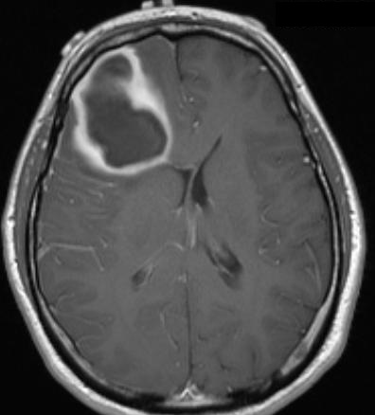
Brain Abscess: Summary slide
Aetiology:
Examination:
Investigations:
Brain abscess is a suppurative collection of microbes within a gliotic capsule occurring within the brain parenchyma.
Risk Factors:
Sinusitis
Otitis Media
Meningitis
Positive Kernig or Brudzinski sign
Increased head circumference (infants)
Papilloedema
History:
Management:
Complications:
Headache: often dull, persistent
Fever: may be absent and usually not the swinging pyrexia seen with abscesses at other sites
focal neurology e.g., oculomotor nerve palsy or abducens nerve palsy secondary to raised ICP.
First line – surgery
a craniotomy is performed, and the abscess cavity debrided
the abscess may reform because the head is closed following abscess drainage.
IV antibiotics: IV 3rd-generation cephalosporin + metronidazole
intracranial pressure management: e.g., dexamethasone
Seizures
Hydrocephalus
Hyponatraemia
Ventriculitis
Notes:
Example of summary slide.
Feel free to rearrange blocks to fit your content
Do not write full prose; use bullet points

